Slide 1
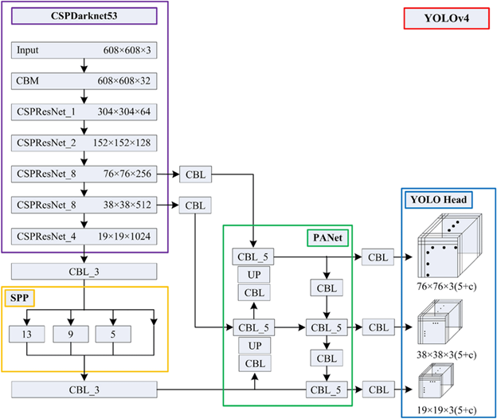
Architecture used in the paper
The newly developed YOLOV4 has been used for face mask detection. This study makes a detection in 2 classes with mask, without mask. The final results of the experiment on test data gives us a mAP (mean average precision) with 98.70 %

Slide 2

Dataset details
The name of dataset used: Labeled Mask Dataset (YOLO_darknet).
The link of the dataset: https://www.kaggle.com/datasets/techzizou/labeled-mask-dataset-yolo-darknet
The total number of samples in the dataset: 1510 images
The dimension of images: various dimensions
Number of classes: 2 classes
Their labels: with_mask / without_mask
“This dataset contains 1510 images belonging to the 2 classes, as well as their bounding boxes in the YOLO format labeled text files.”

Slide 3

Implementation details
We made preprocessing steps following the yolov4 darknet official repo guidelines this pre-processing steps leads us to make the required structure for the data to start training.
Training ratio: 90% (1359)
Testing ratio: 6.6% (100)
Validation ratio: 3.4% (51)
Hyperparameters used:
Testing batch=1 subdivisions=1
Training batch=64 subdivisions=16
width=640 height=640
channels=3 momentum=0.949
learning_rate=0.001 burn_in=1000
max_batches = 6000 policy=steps
steps=4800,5400 scales=.1,.1

Slide 4
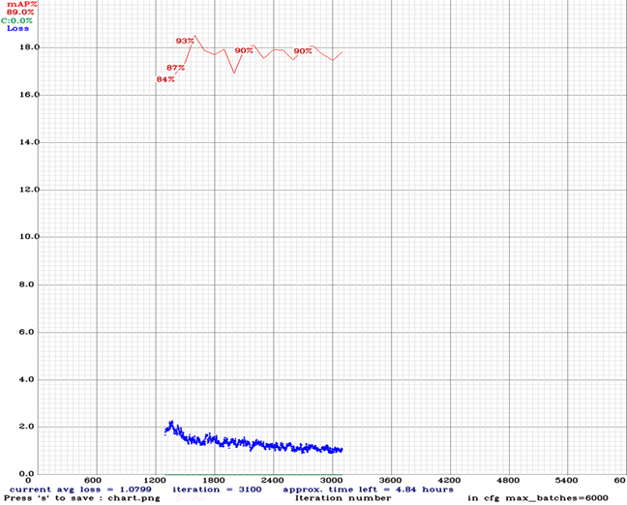
Results and visualization
Precision | Recall | F1-Score | Average IoU | mAP
0.94 | 0.96 | 0.95 | 73.93% | 98.70 %
Result details: (On testing data):
**The curve doesn’t go from up to down intensely because it’s the chart of the last training time.

